Slide 1
Financial Risk Assessment Using Interactive Dashboards
TEAM – 5
Praharsha • Sindhura • Madeeha • Santhosh
1

Slide 2
Introduction
In today’s data-driven environment, large volumes of information can hide important patterns and potential risks. Turning this raw information into clear insights is essential for faster and smarter decision-making. Our project uses preprocessed financial risk data and interactive analytics to transform complex information into meaningful visual stories. Through dashboards, we can quickly assess risk, discover patterns, monitor key indicators, and support proactive decision-making. The framework brings together four major perspectives: • Risk Assessment • Predictive Analytics • Executive-Level Monitoring • Alerting and Performance Optimization
2

Slide 3
Objectives
The project is designed to convert data into actionable intelligence through powerful dashboard analytics
Assess Risk Clearly Develop an interactive dashboard to identify and monitor different risk levels.
Discover Predictive Patterns Analyze historical indicators to recognize patterns associated with potential future risk.
Empower Decision-Makers Create an executive command-center view that presents key information in one place.
Enable Proactive Monitoring Highlight critical indicators for alerting, monitoring, and timely action.
Optimize Performance Support continuous improvement through data-driven insights and performance analysis.
3

Slide 4
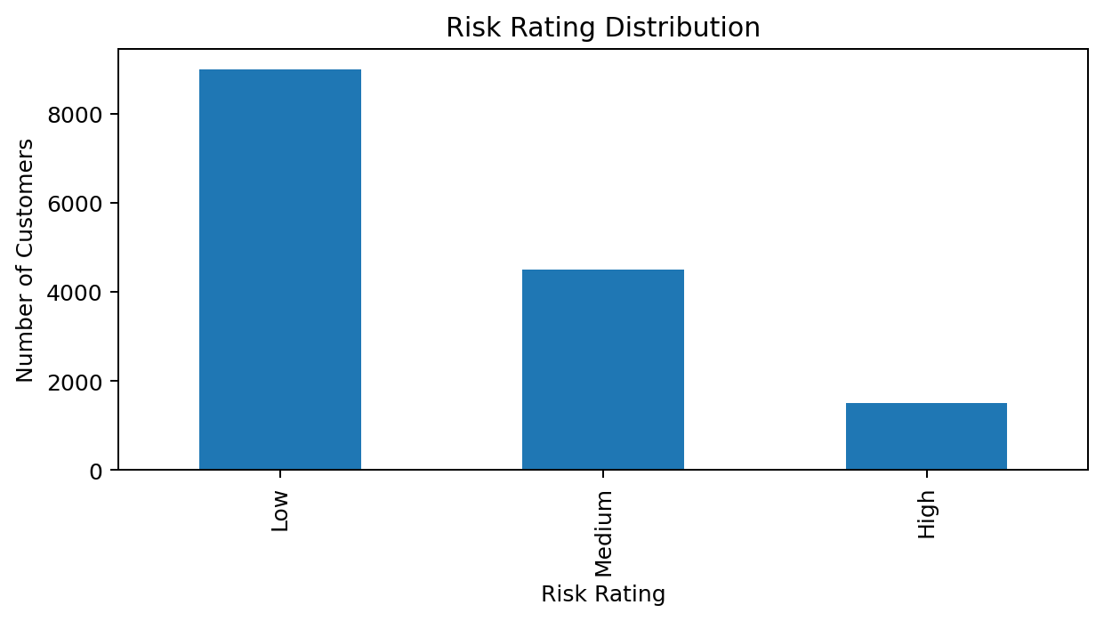
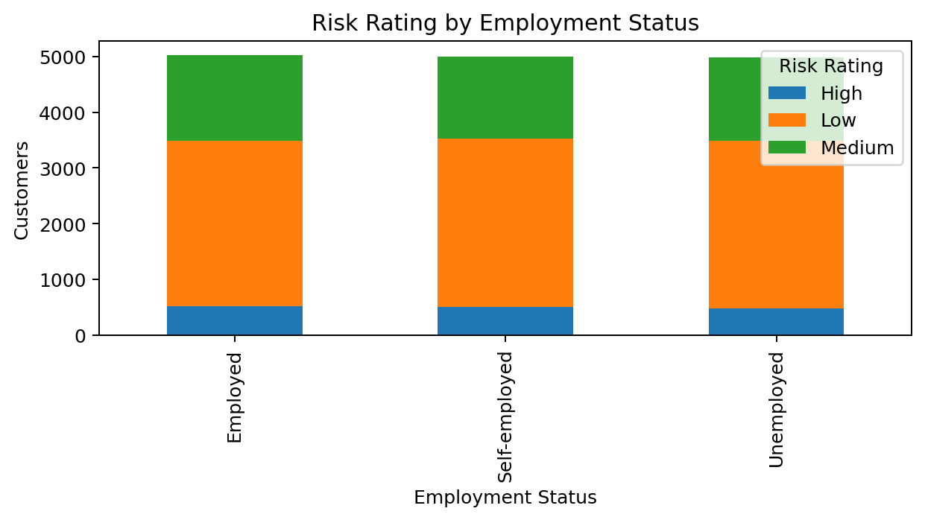
Security Risk Assessment Dashboard
Overall view of customer risk and key financial indicators
Total Records
15,000
High-Risk Customers
1,500
Average Credit Score
699.09
Key Insight: The dashboard provides a quick assessment of overall risk distribution and customer risk patterns.
4

Slide 5
Security Risk Assessment – Risk Distribution
Key Insight: Risk distribution identifies the concentration of Low, Medium, and High-risk customers, while employment analysis compares risk across employment groups.
5

Slide 6
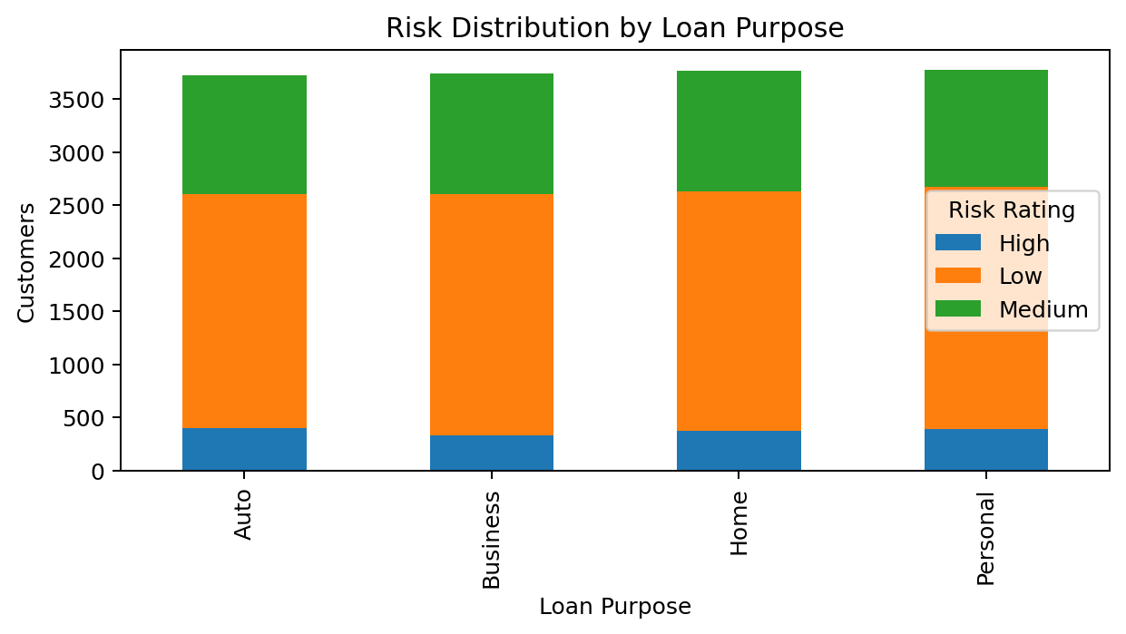
Security Risk Assessment – Detailed Risk Analysis
Risk by Loan Purpose
Shows how customer risk is distributed across different loan purposes.
Risk Assessment Value
Helps identify categories that require greater monitoring and risk-control attention.
Decision Support
Supports prioritization of high-risk customer segments and loan categories.
6

Slide 7
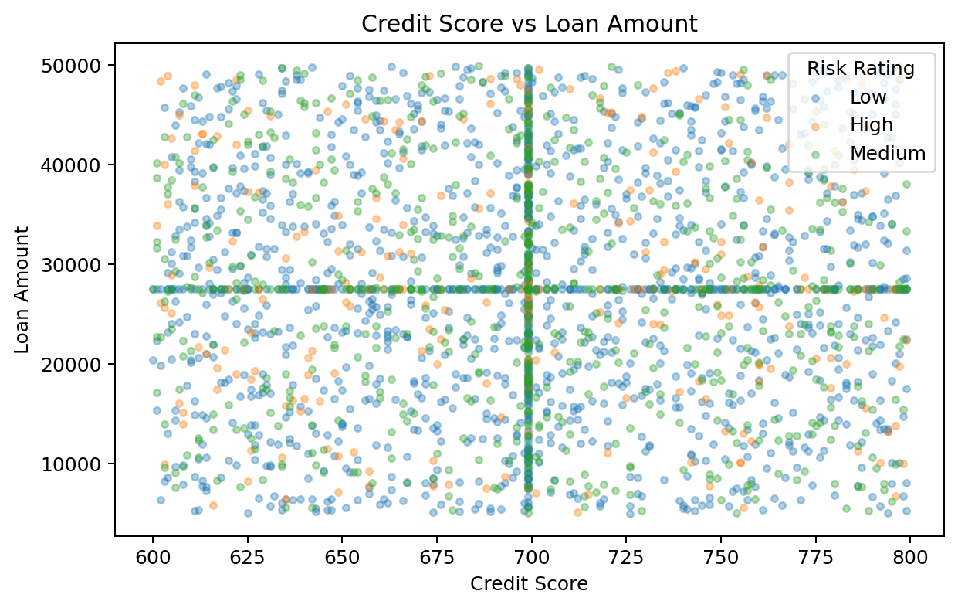
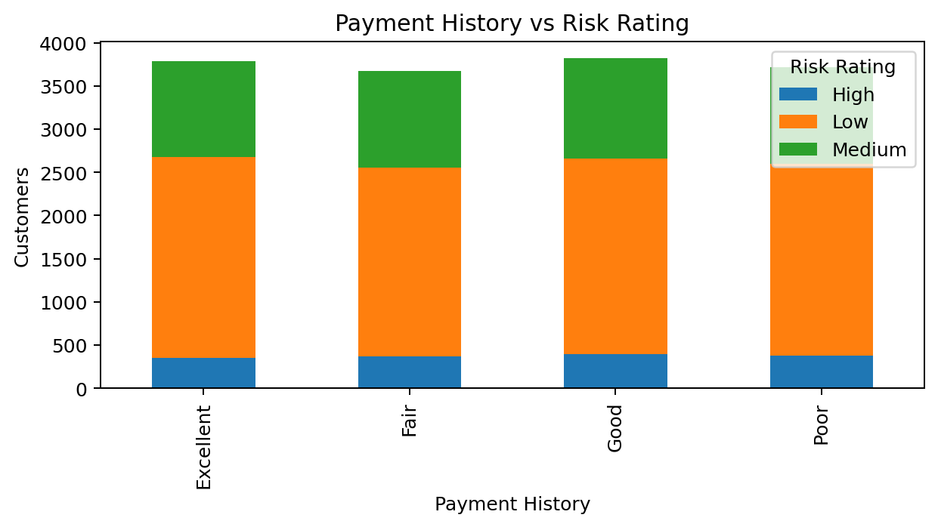
Predictive Threat Analytics
Pattern-based analysis using historical financial risk indicators
Average Income
69,909
Average Loan Amount
27,464
Average Debt-to-Income Ratio
0.35
Key Insight: Historical relationships among credit score, loans, income, and payment behavior help identify patterns associated with future risk.
7

Slide 8
Predictive Threat Analytics – Risk Pattern Analysis
Key Insight: Credit score and payment history are useful indicators for understanding borrowing behavior and identifying potentially higher-risk patterns.
8

Slide 9
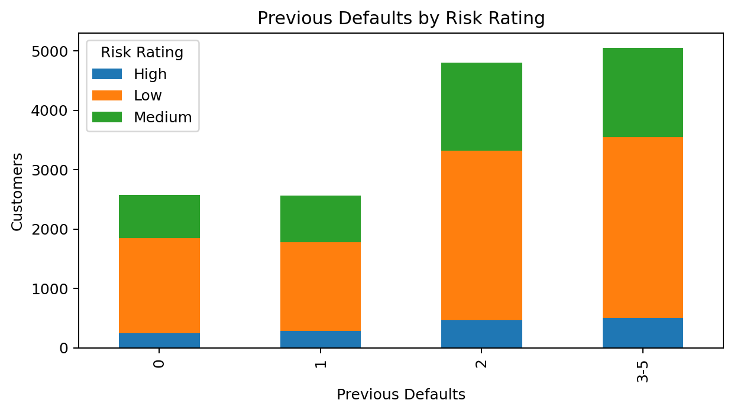
Predictive Threat Analytics – Previous Defaults & Insights
Predictive Risk Indicators
Previous defaults
Payment history
Credit score
Debt-to-income ratio
Key Insight
Combining historical indicators supports proactive identification of higher-risk patterns.
9

Slide 10
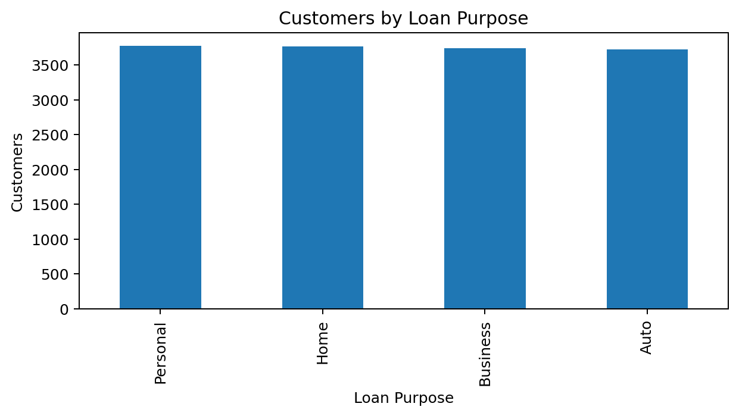
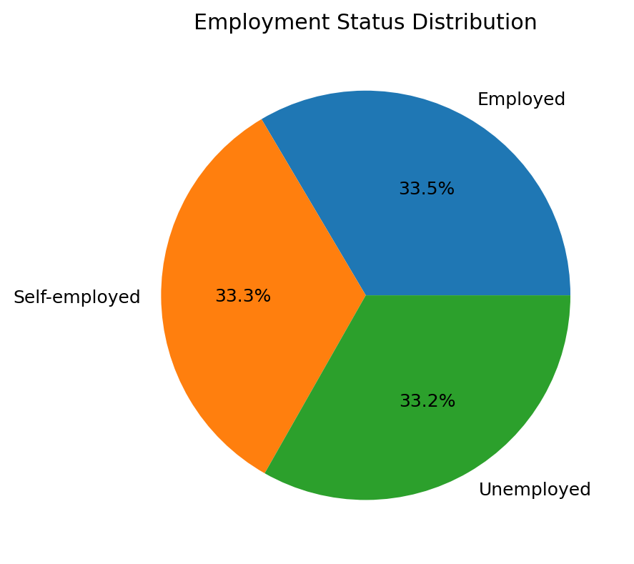
Executive Command-Center Dashboard
High-level overview for management and decision-makers
Total Customers
15,000
High-Risk Customers
1,500
Average Loan Amount
27,464
Key Insight: The command center consolidates major indicators into a single view for faster executive monitoring and decision-making.
10

Slide 11
Executive Command-Center – Business Overview
Key Insight: Loan purpose and employment profiles provide management with a clear overview of customer composition and financial exposure.
11

Slide 12
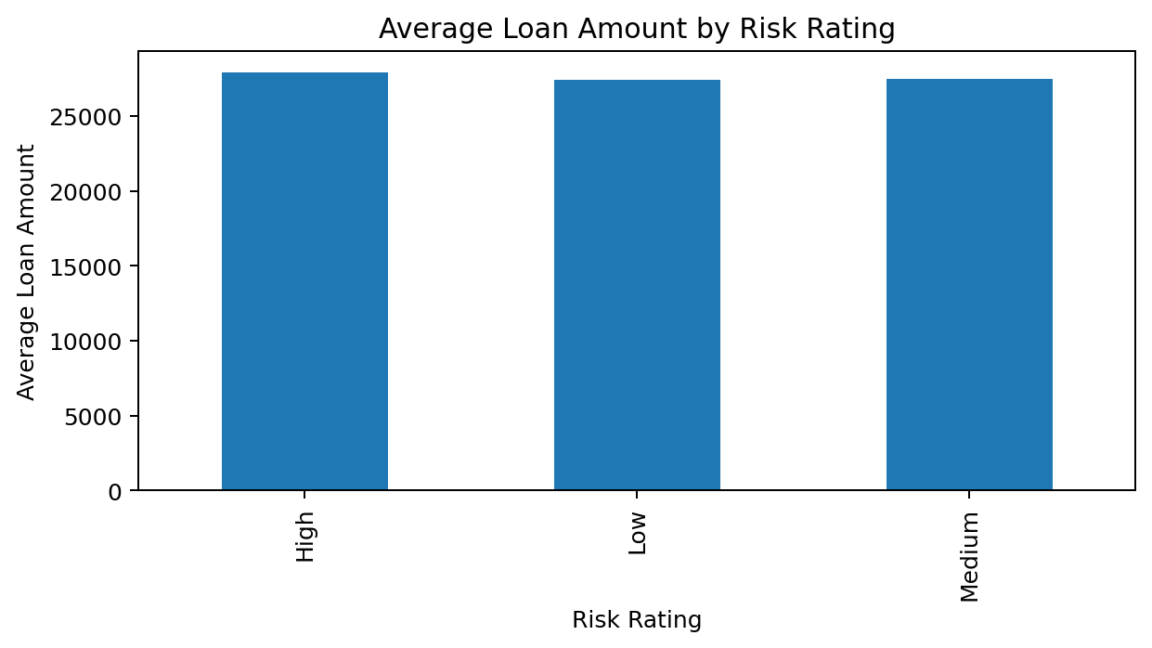
Executive Command-Center – Decision-Making Insights
Executive Risk Summary
Monitor overall risk exposure.
Compare loan amounts across risk categories.
Identify high-priority customer segments.
Support strategic and data-driven decisions.
Management Benefit
Important financial indicators are available in one centralized analytical view.
12

Slide 13
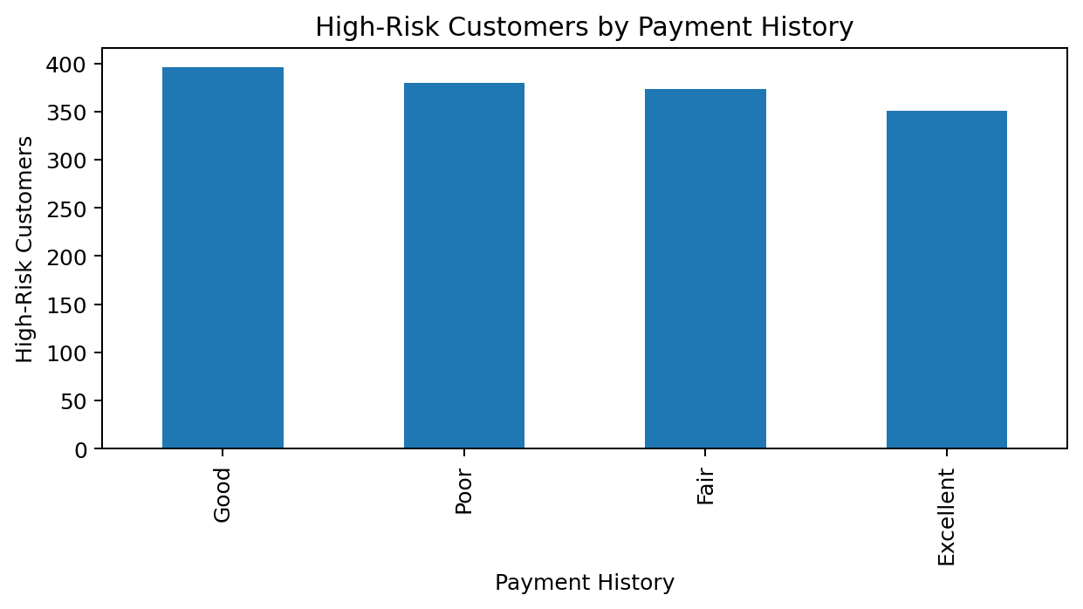
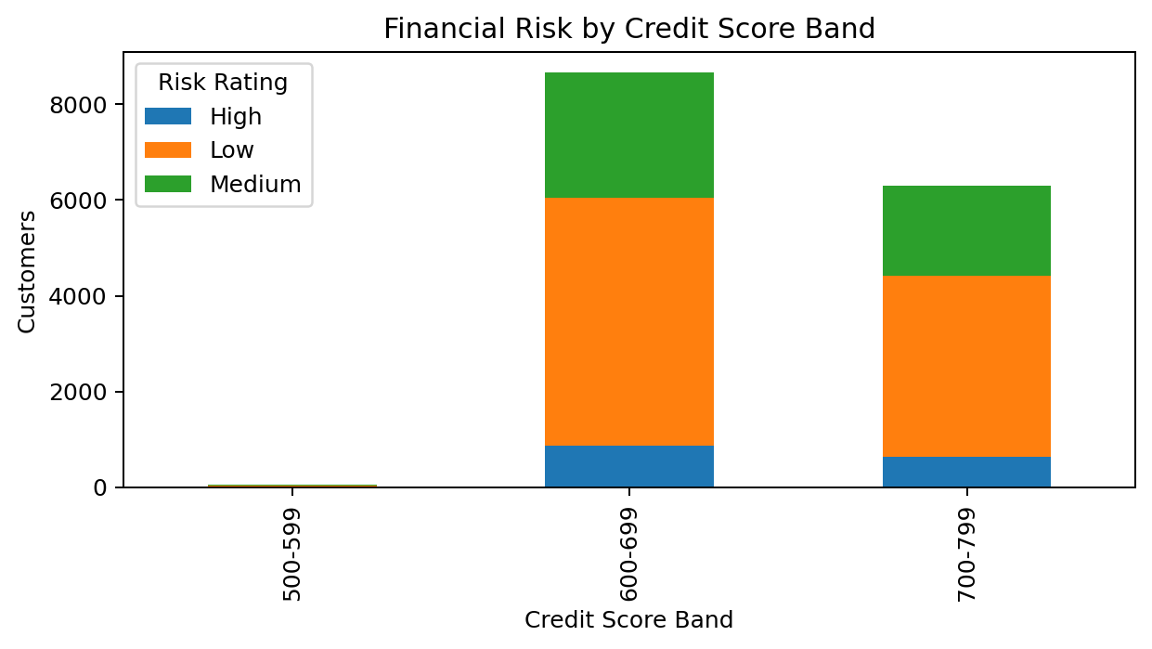
Forecasting, Alerting, Security & Performance Optimization
Monitoring critical indicators and supporting proactive risk management
High-Risk Customers
1,500
Customers with Defaults
12,429
Average Assets Value
159,685
Key Insight: Critical risk indicators can be monitored to highlight situations that require attention and improve proactive risk management.
13

Slide 14
Forecasting & Alerting – Risk Monitoring
Key Insight: High-risk customers can be monitored through payment behavior and credit-score bands to support alert prioritization.
14

Slide 15
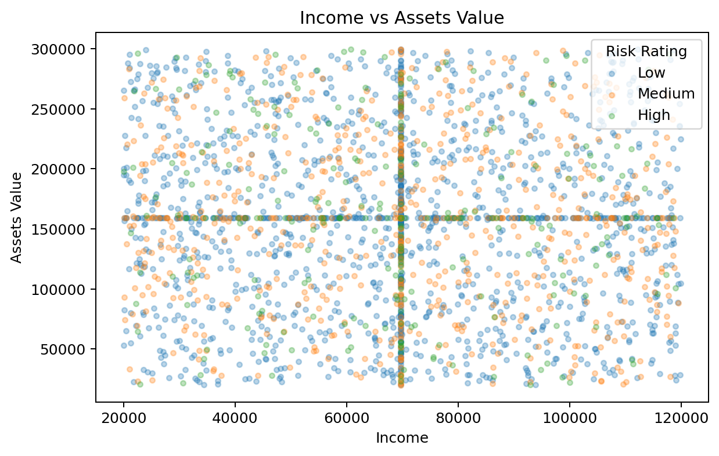
Security & Performance Optimization
Performance Optimization Focus
Analyze relationships between income and assets.
Identify customer segments requiring attention.
Improve monitoring and resource allocation.
Support proactive financial risk management.
Overall Value
Combining monitoring, alerts, and performance indicators supports continuous improvement.
15

Slide 16
Conclusion
This project demonstrates how preprocessed data can be transformed into meaningful and actionable insights through interactive dashboard analytics.
The Security Risk Assessment Dashboard provides a clear view of overall risk.
Predictive Analytics helps uncover important patterns and potential future risks.
The Executive Command-Center brings key indicators together for faster decision-making.
Alerting and Performance Optimization support continuous monitoring and improvement. Overall, the framework shows how data visualization can simplify complex information, strengthen risk awareness, and support smarter, faster, and more confident decisions.
16

Slide 17
THANK YOU
16

